Slide 1
CHANDIDAS MAHAVIDYALAYA
DEPARTMEANT OF GEOGRAPHY
Topic.- Hoyt’ s Sector model
Prof.- Indrajit Mandal

Slide 6
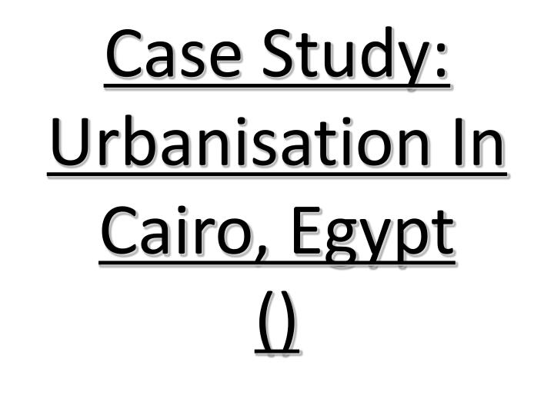

Slide 15
Thank You

